Slide 1
Multimedia Systems Lecture – 20
By
Dr. Priyambada Subudhi
Assistant Professor
IIIT Sri City

Slide 2
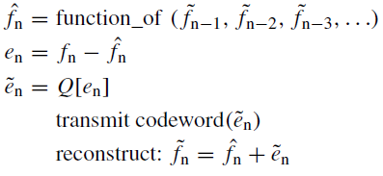
Differential Pulse Code Modulation (DPCM) is exactly the same as Predictive Coding, Predictive coding except that it incorporates a quantizer step.
We shall call the original signal f_{n}, the predicted signal , and the quantized, reconstructed signal . How DPCM operates is to form the prediction, from an error e_{n} by subtracting the prediction from the actual signal, then quantize the error to a quantized version, .
The equations that describe DPCM are as follows

Slide 3
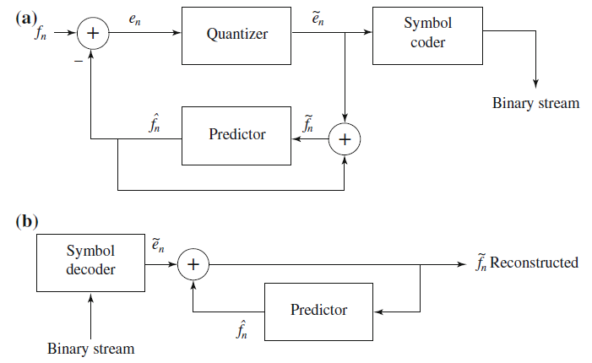
Schematic diagram for DPCM: a encoder; b decoder

Slide 4


Codewords for quantized error values are produced using entropy coding, such as Huffman coding.
Notice that the predictor is always based on the reconstructed, quantized version of the signal : the reason for this is that then the encoder side is not using any information not available to the decoder side.
The main effect of the coder–decoder process is to produce reconstructed, quantized signal values
The distortion is the average squared error
The predictor makes use of the reconstructed, quantized signal values not actual signal values f_{n}—that is, the encoder simulates the decoder in the predictor path. The quantizer can be uniform or nonuniform.

Slide 5



The prediction value is based on however much history the prediction scheme requires: we need to buffer previous values of to form the prediction.
Notice that the quantization noise, is equal to the quantization effect on the error term, .
Example: Suppose we adopt a particular predictor as
the particular quantization scheme
Suppose we wish to code the sequence f1, f2, f3, f4, f5 = 130, 150, 140, 200, 230.

Slide 6
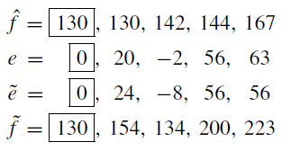
We prepend extra values f₀ = 130 in the datastream that replicate the first value, f₁, and initialize with quantized error , so that we ensure the first reconstructed value is exact: .
Then subsequent values calculated are as follows

Slide 7
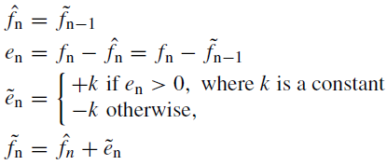
Delta Modulation (DM)
It is a much-simplified version of DPCM often used as a quick analog-to-digital converter.
Uniform-Delta DM
The idea in DM is to use only a single quantized error value, either positive or negative. Such a 1-bit coder thus produces coded output that follows the original signal in a staircase fashion.
The relevant set of equations is as follows:

Slide 8


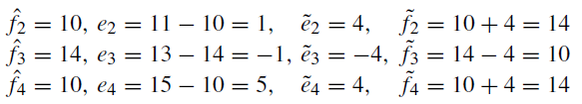
Note that the prediction simply involves a delay.
Example: Suppose signal values are as follows
We also define an exact reconstructed value
Suppose we use a step value k = 4. Then we arrive at the following values:
We see that the reconstructed set of values 10, 14, 10, 14 never strays far from the correct set 10, 11, 13, 15.
It is not difficult to discover that DM copes well with more or less constant signals, but not as well with rapidly changing signals.

Slide 9
Adaptive DM
However, if the slope of the actual signal curve is high, the staircase approximation cannot keep up.
A straightforward approach to dealing with a steep curve is to simply change the step size k adaptively—that is, in response to the signal’s current properties.

Slide 10
Commonly Used Audio Formats
Digital audio formats emerged with the use and distribution of CD audio discs. These were uncompressed pulse code modulated digital signals in mono and in stereo (Mono signals are recorded and played back using a single audio channel, while stereo sounds are recorded and played back using two audio channels).
However, a number of formats have now become mainstream with the need for streaming, mobile, and surround sound technologies (Surround sound is a technique for enriching the fidelity and depth of sound reproduction by using multiple audio channels from speakers that surround the listener (surround channels). Its first application was in movie theaters).

Slide 11
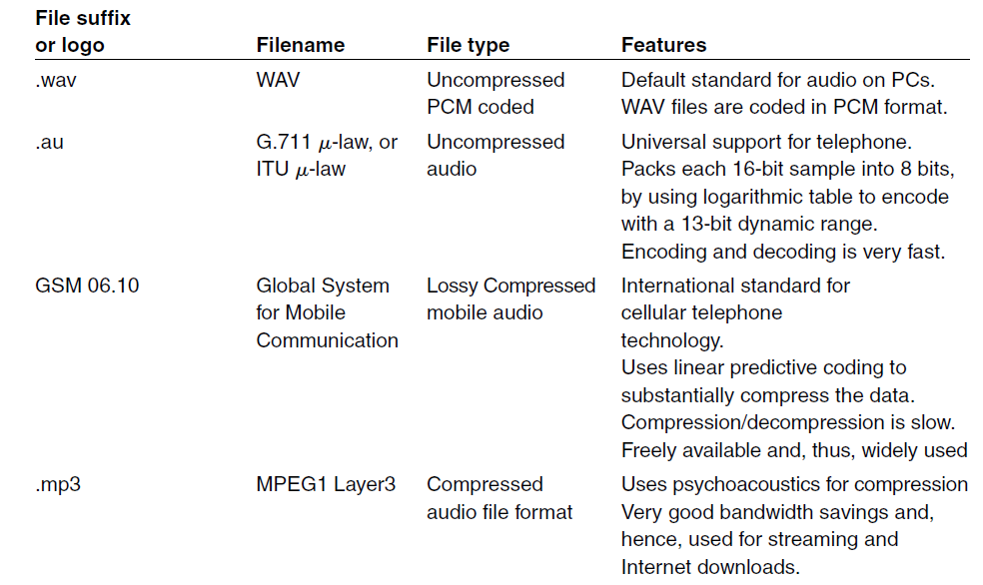

Slide 12
